Slide 1
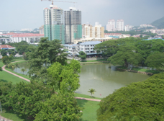
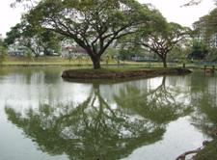




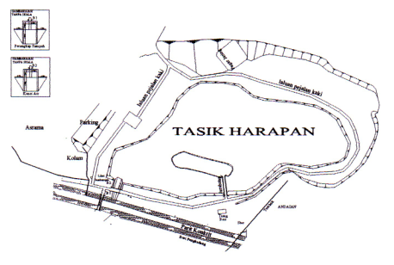
Eutrophication (Algae) Model

Slide 2
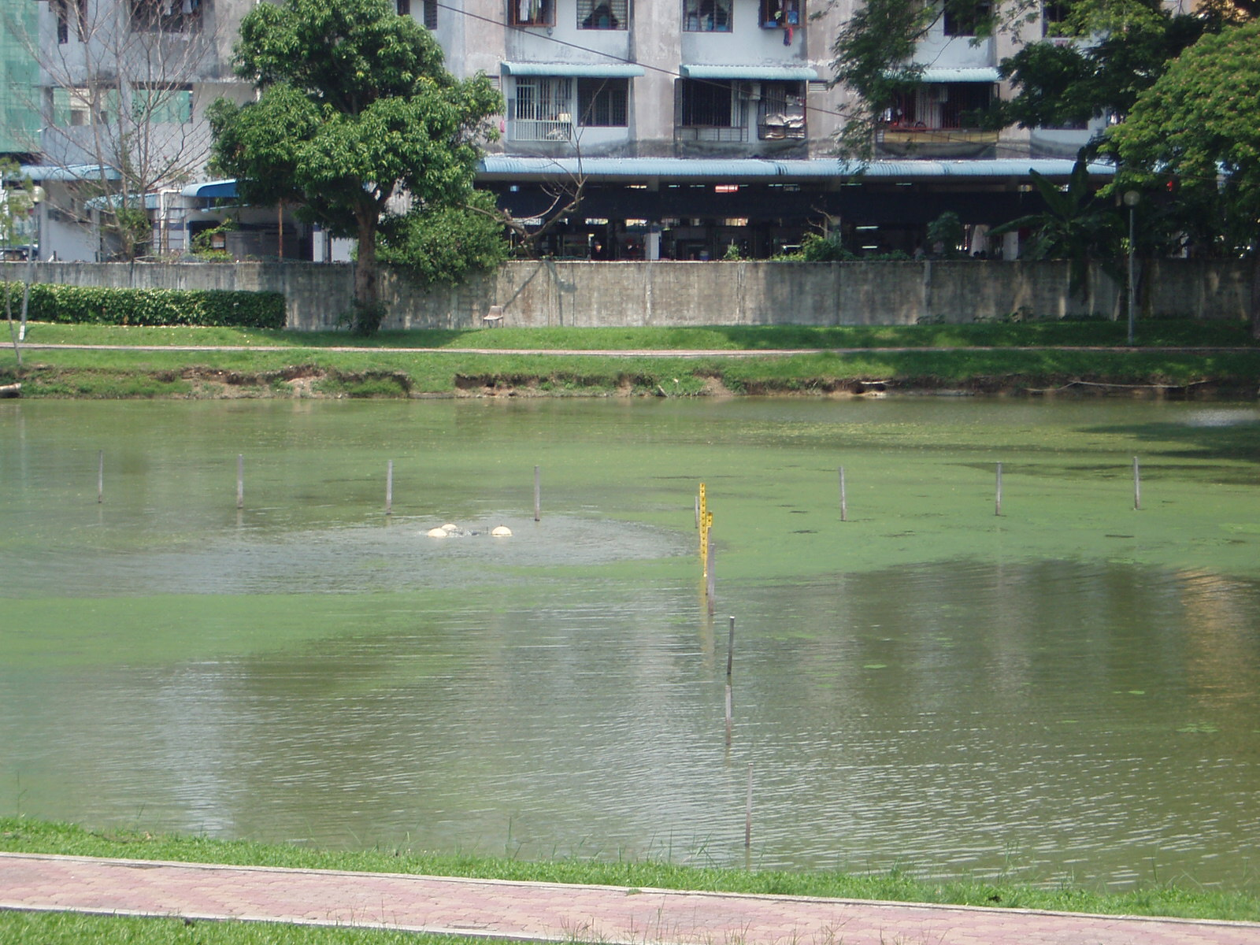
The aerator

Slide 3

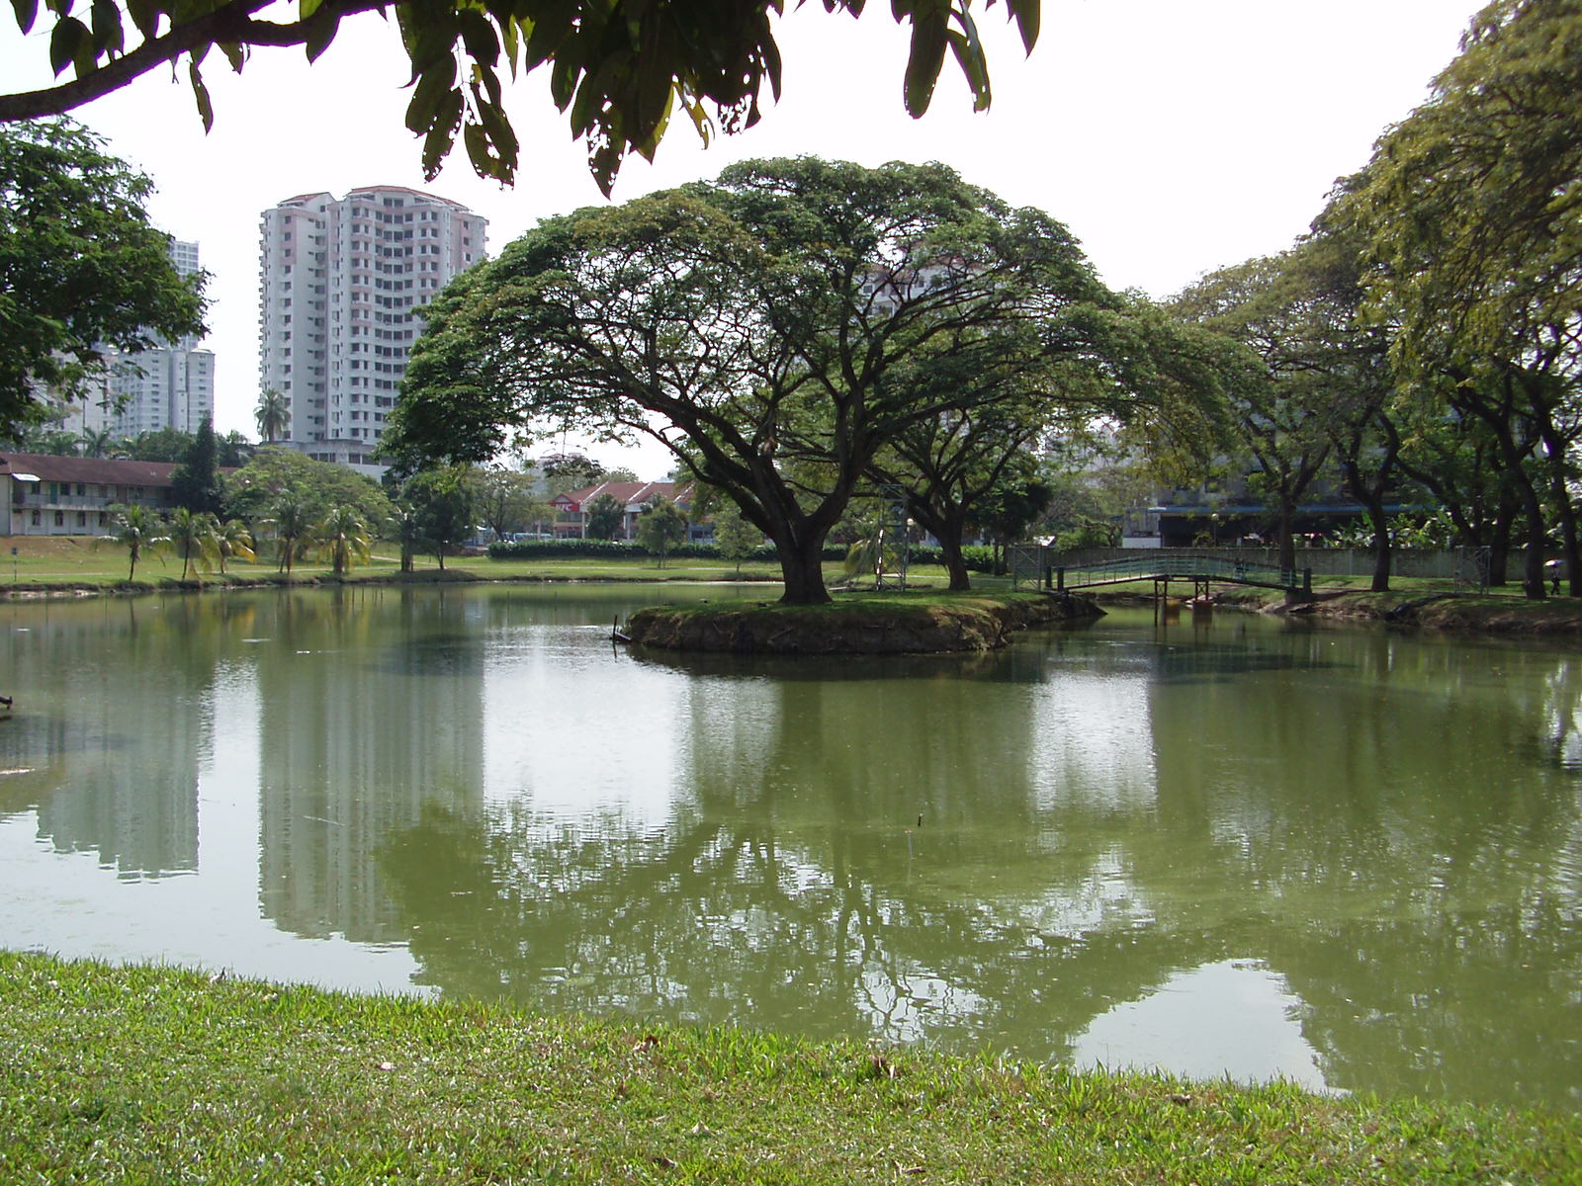

Tasik Harapan: what we have
Eutrophic lake

Slide 4
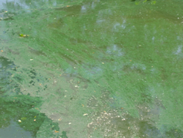
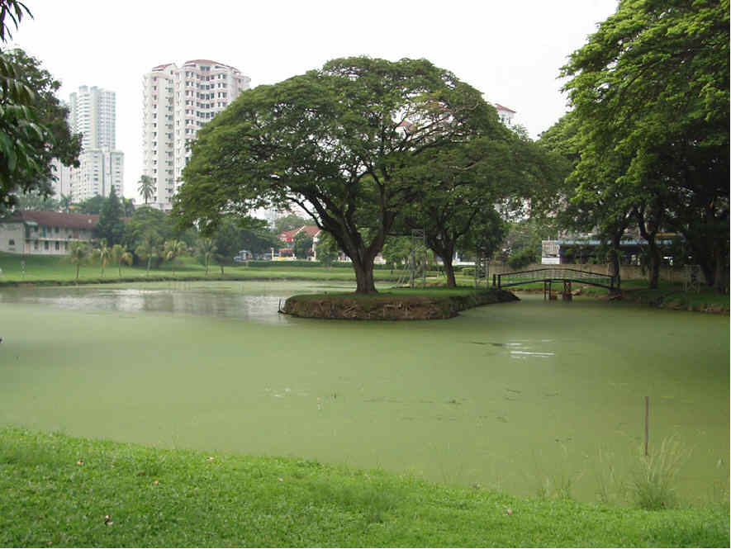
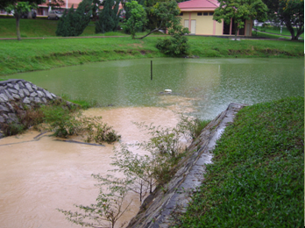
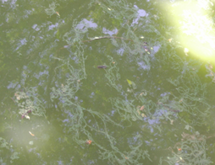
Tasik Harapan: what we get
Algae Bloom

Slide 5
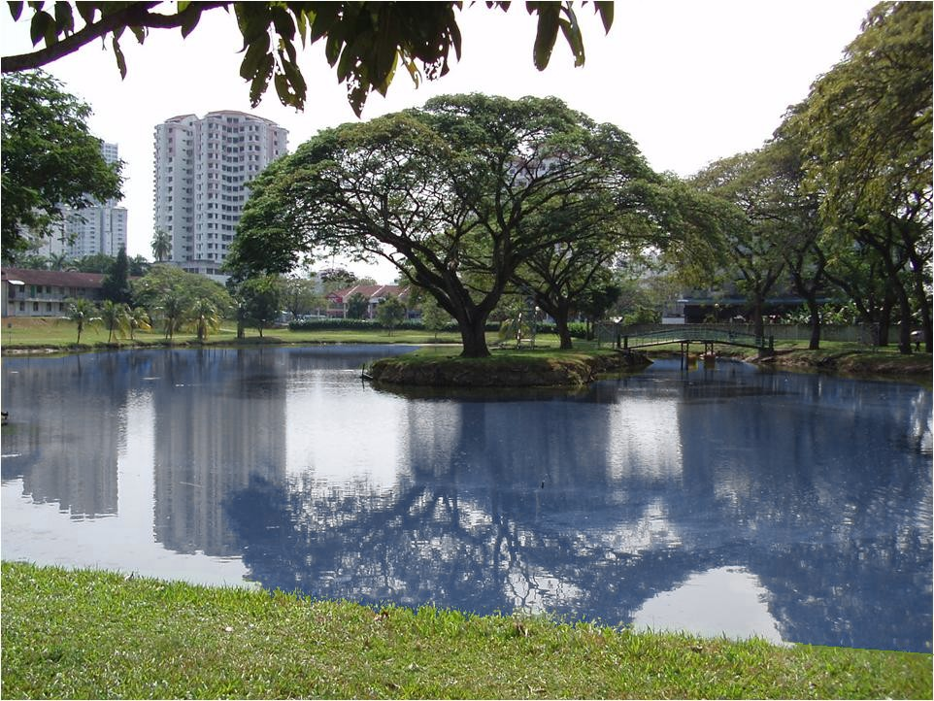
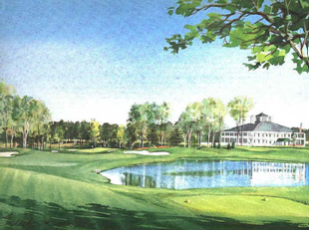
Tasik Harapan: what we want
Healthy Lake

Slide 6
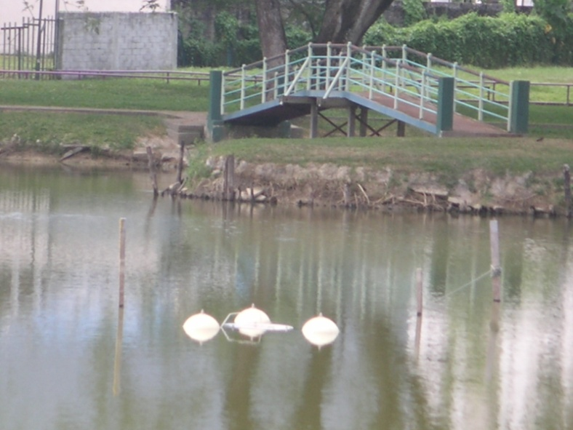
Tasik Harapan Aerator
The aerator

Slide 7
Water Quality Parameters
Table 1 Mean water quality parameters for Tasik Harapan
Parameter | Mean ± s.d
DO (mg/L) | 5.20 ± 1.900
BOD (mg/L) | 8.00 ± 2.000
Chlorophyll a (mg/L) | 0.33 ± 0.064
Table 2 Mean water quality parameters used in this paper
Parameter | Mean values
DO (mg/L) | 5.20, 6.00
DO (saturation) (mg/L) | 7.50
BOD (mg/L) | 8.00
Chlorophyll a (mg/L) | 0.33

Slide 8
Analytical Model
= BOD level, mg/L
c = DO level, mg/L
c_{s} = DO saturation level, mg/L
t = time, day
β = reaeration rate, day⁻¹
γ = BOD loading, mg/L/day;
α = BOD decay rate, day⁻¹
σ = frequency for a 1-day cycle, 2π /day

Slide 9
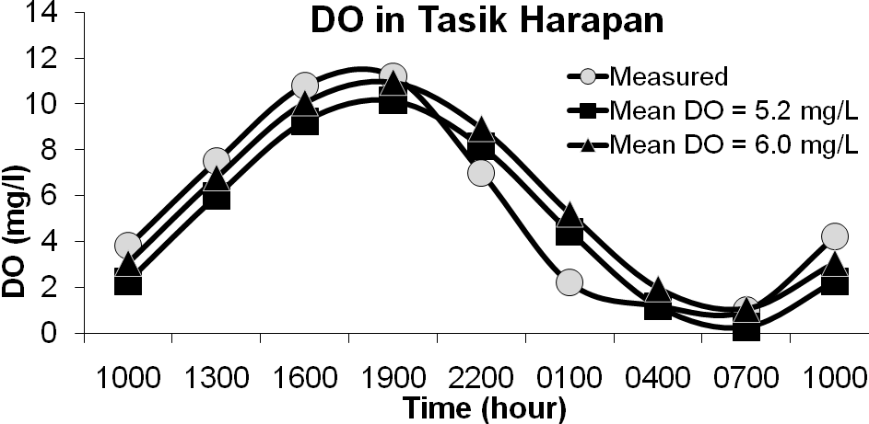
Measured and simulated DO

Slide 10
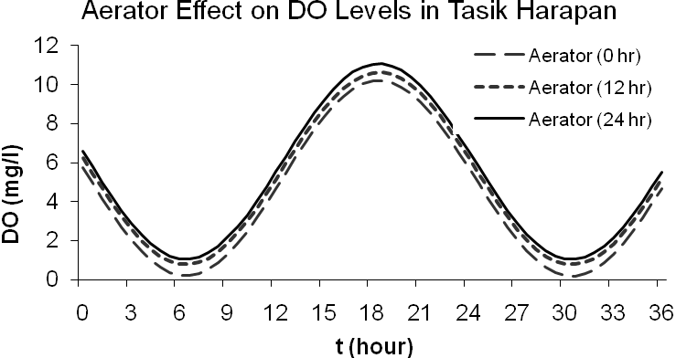
Aerator effect on DO levels in Tasik Harapan

Slide 11
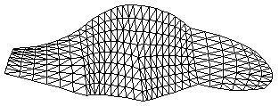
Finite Element

Slide 12
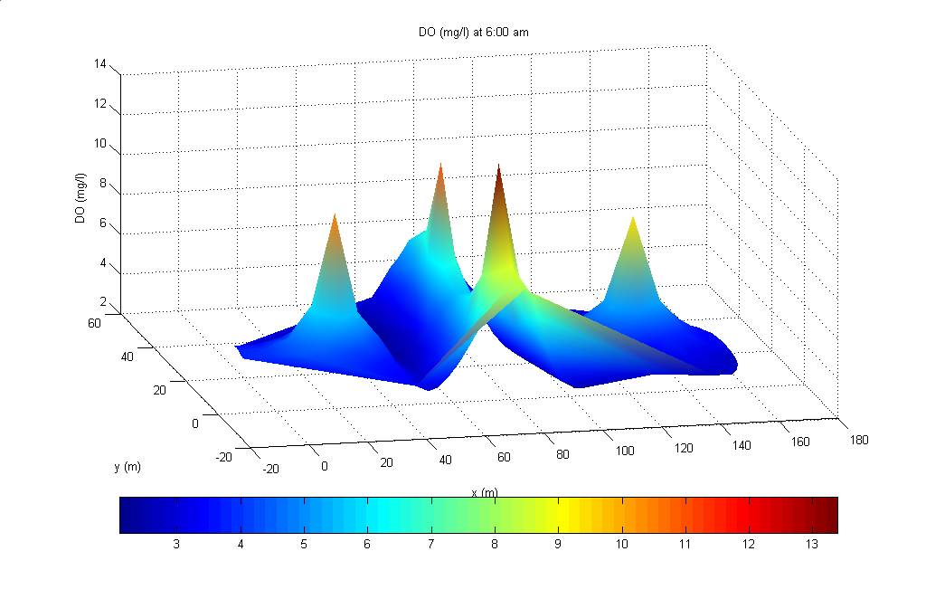
Mechanical Aerator
One aerator
Four aerators

Slide 13
TH Measured Do

Slide 14
Refined photosynthesis model
Table 3 Respiration rates R_{e} (mg/L/d) estimated using linear regression
Day | Experiment 1 |  | Experiment 2
 | R_{e} | R² | R_{e} | R²
1 (26/11/04) | 1.6 | 0.716 | 1.4 | 0.879
2 (28/11/04) | 3.6 | 0.986 | 3.4 | 0.987
3 (30/11/04) | 3.9 | 0.991 | 3.8 | 0.979
4 (04/12/04) | 4.7 | 0.996 | 4.1 | 0.987
5 (05/12/04) | 5.6 | 0.959 | 4.8 | 0.969
Table 4 Reaeration rates β d⁻¹
Experiment | Date
 | 26 Nov | 28 Nov | 30 Nov | 4 Dec | 5 Dec
1 | 4.3 | 6.2 | 4.4 | 3.3 | 3.7
2 | 5.2 | 7.0 | 4.4 | 3.3 | 4.3

Slide 15
Refined photosynthesis model
Table 5 Photosynthesis rate δ mg/L/d in lake and bottles estimated using curve regression
Day | Tank 1 |  | Tank 2 |  | Tasik Harapan
 | δ₁ | C | δ₂ | C | δ_{TH} | C
1 | 43.7 | 0.85 | 43.4 | 0.83 | 33.5 | 0.97
2 | 47.1 | 0.87 | 44.0 | 0.89 | 25.5 | 0.92
3 | 37.7 | 0.94 | 37.7 | 0.95 | 27.0 | 0.95
4 | 48.1 | 0.92 | 50.1 | 0.94 | 43.3 | 0.95
5 | 50.7 | 0.93 | 51.6 | 0.93 | 34.4 | 0.94

Slide 16
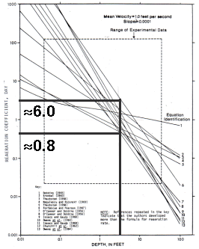
USEPA Reaeration β Estimation

Slide 17
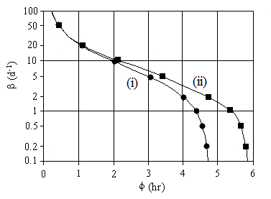
Delta Method β Estimation
Estimation of β using (i) Delta Method (ii) time of DO peak, φ = tan⁻¹ (σ/β)

Slide 18
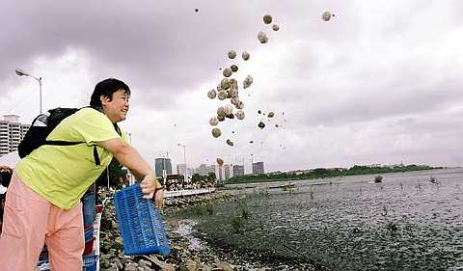
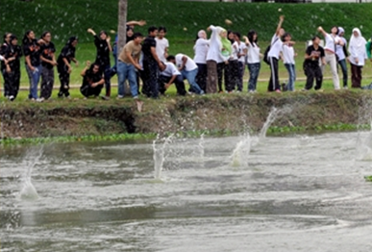
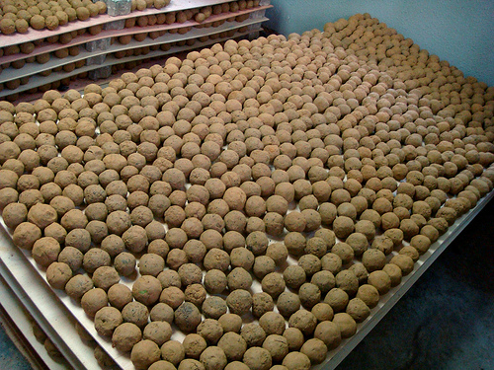
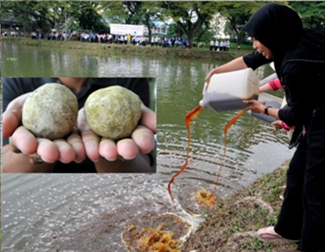
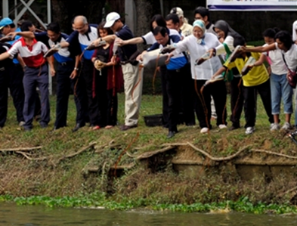
Role of Mudball & EM Solution

Slide 19
Role of Mudball & EM Solution
Lurling, M., Tolman, Y. and van Oosterhout, F. (2010). Cyanobacteria blooms cannot be controlled by Effective Microorganisms (EM®) from mud- or Bokashi-balls. Hydrobiologia 646, 133–143.

Slide 20
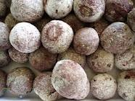
Role of Mudball & EM Solution
An attempt has been made beginning August 2010 to use mudball and effective microorganism (EM);
In an effort to improve water quality in Tasik Harapan, with undocumented success (Asha et al., 2010);
We therefore attempted to verify the effectiveness of the EM solution method by comparing DO level in Tasik Harapan for the period November-December 2004 and the period December 2010-January 2011.

Slide 21
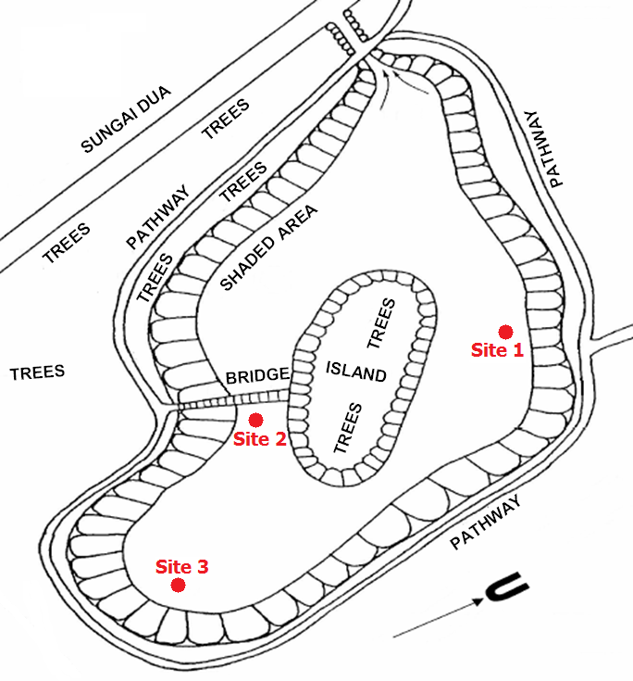
Three sampling sites at Tasik Harapan

Slide 22
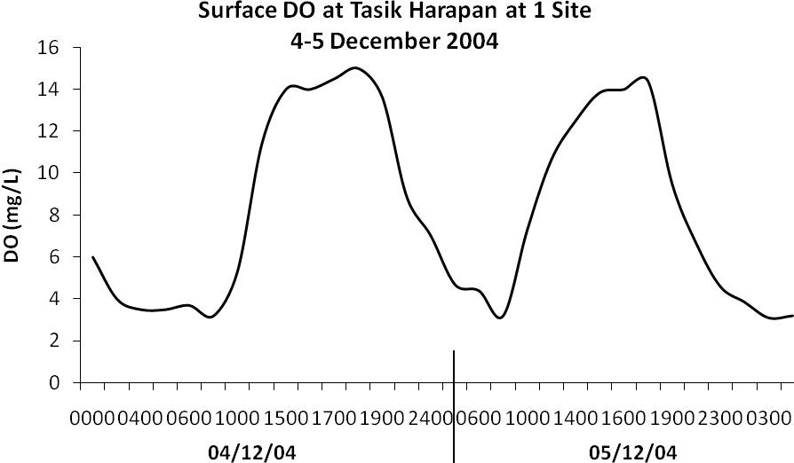
Tasik Harapan Measured DO 4-5 Dec 2004
Over the diurnal cycle, surface DO varies from a low of around
3.5 mg/L in the early part of the morning (6:00 am) to a maximum of
15 mg/L in the late afternoon (5:00 pm) on 4-5 December 2004.

Slide 23
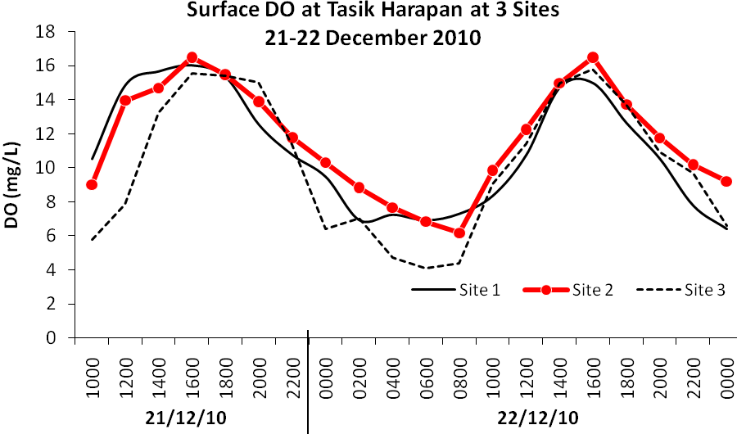
Tasik Harapan Measured DO 21-22 Dec 2010
For the period four months after continuous EM release (Dec 2010 to Jan 2011), the surface DO varies between a low of about 4 mg/L in the early morning to a high of 17 mg/L in the late afternoon

Slide 24
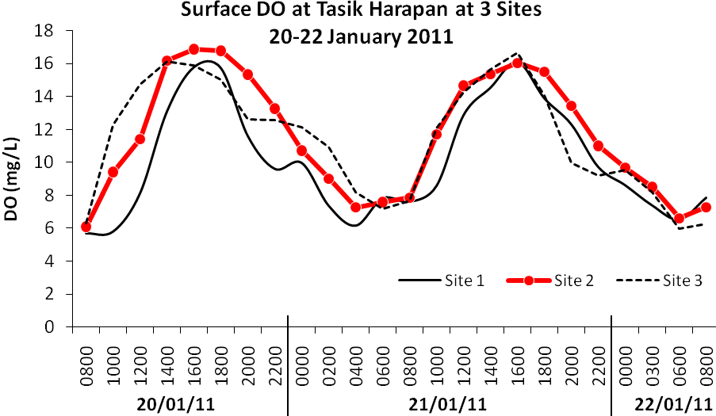
Tasik Harapan Measured DO 20-22 January 2011
For the period four months after continuous EM release (Dec 2010 to Jan 2011), the surface DO varies between a low of about 4 mg/L in the early morning to a high of 17 mg/L in the late afternoon

Slide 25
Role of Mudball & EM Solution
DO 2004 : 3.5 – 15 mg/L;
DO 2011 after application of mudball & EM : 4 – 7 mg/L;
Diurnal patterns of DO before and after the continuous release of EM demonstrate close similarity;
Post EM-release DO indicates increase DO levels due to increased photosynthesis;
⇒ Eutrophic state in TH has not been reduced by four months of release of EM.

Slide 26
Role of Mudball & EM Solution
Based upon this preliminary data;
It may be surmised that the continuous release of EM in TH;
May have even caused a slight increase in photosynthesis;
If we allow ourselves the liberty to use photosynthesis = eutrophication;
Then we may arrive at the tentative findings;

Slide 27

Role of Mudball & EM Solution
That EM solution application in Tasik Harapan might have even contributed slightly to increase eutrophication, contrary to its planned objective;
Anecdotal evidence, as witnessed from the deep green color of Tasik Harapan, may add further credential to this hypothesis;
In any case, the jury is still out in the open, awaiting further in-depth analysis.

Slide 28
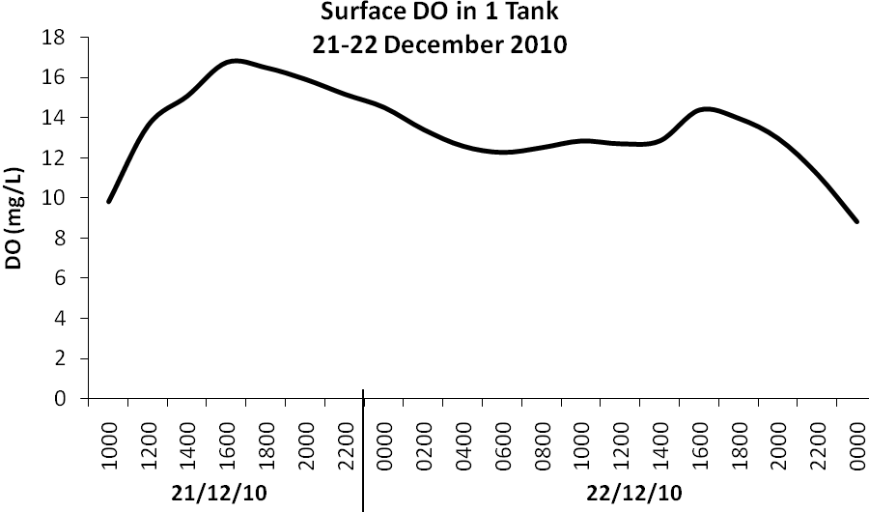
Role of atmospheric reaeration

Slide 29
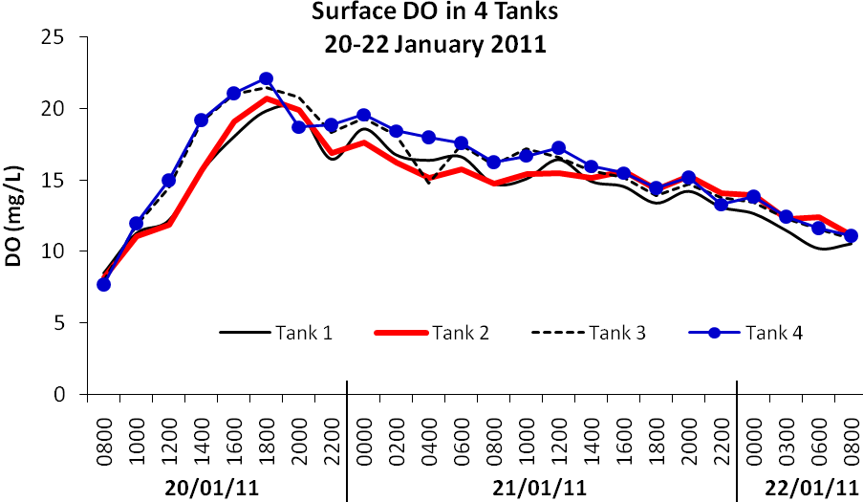
Role of atmospheric reaeration

Slide 30
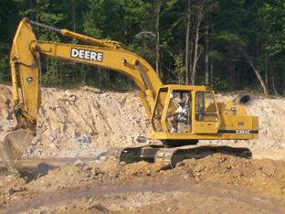
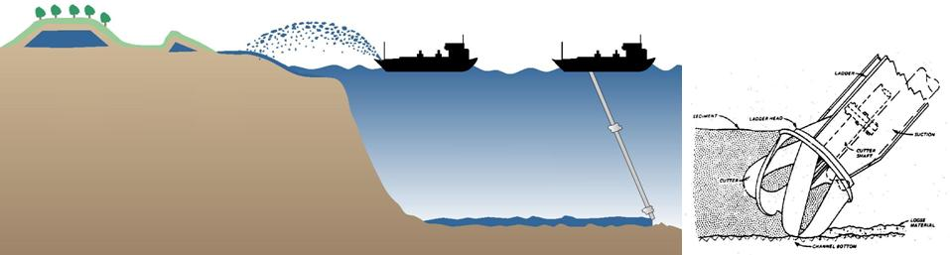
Removal of sediment nutrients
Mechanical aeration is not a solution to eutrophication;
Similarly, EM solution and mudball;
Removal of nutrients accumulated in the sediment layers;
Is a viable option to rehabilitateTasik Harapan;

Slide 31
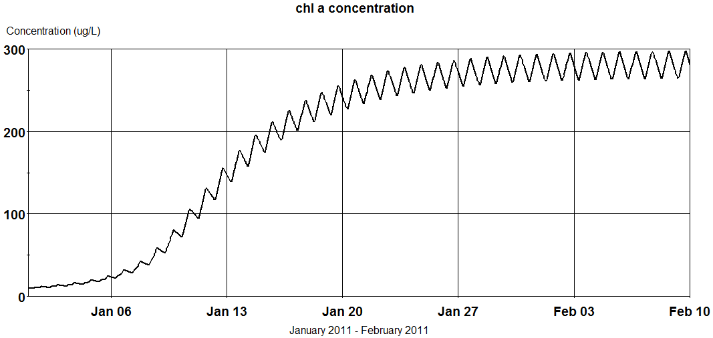
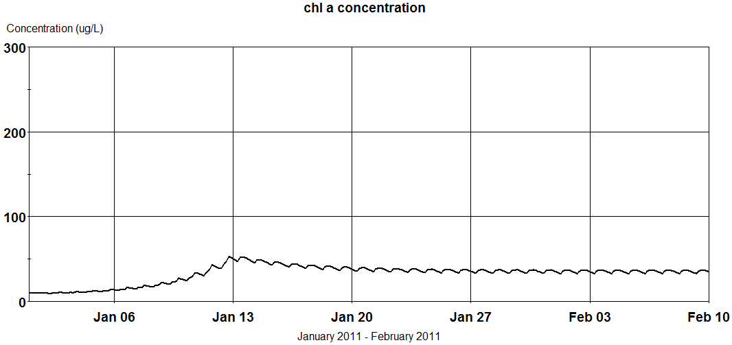
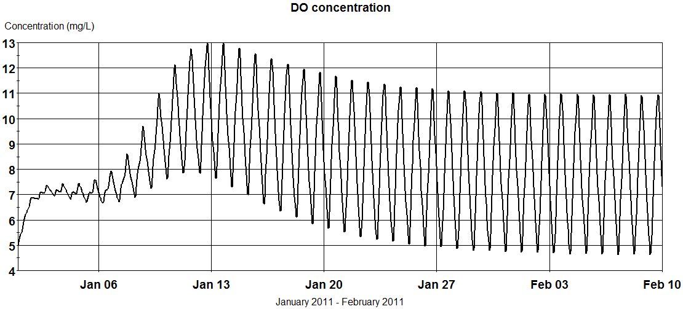
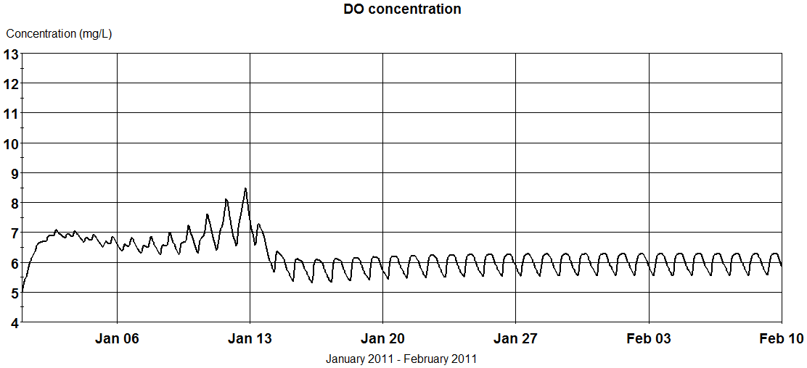
Removal of sediment nutrients
Before Removal
After Removal

Slide 32
Conclusion
Tasik Harapan is highly eutrophicated;
Wild fluctuation of DO over the diurnal cycle;
Reaching 18 mg/L in late afternoon;
Mechanical aerator not effective;
Does not remove the source of nutrients;
Adding DO is meaningless in TH;

Slide 33
Conclusion
Mudball and EM solution did not appear to reduce the degree of eutrophication in Tasik Harapan;
Addition of mudballs may even ↑ turbidity;
And add additional nutrients;
Further complicate eutrophication process;
Removal of sediment from the lake bottom;
Viable option that deserves more careful study;

Slide 34
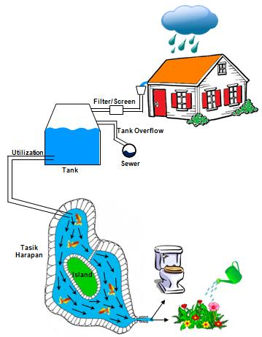
Conclusion
Sediment removal is sustainable in long run;
If a source of water can be found;
In the form of rainwater harvesting;
To provide flow to Tasik Harapan;
Should be closely look at in the near future.

Slide 35
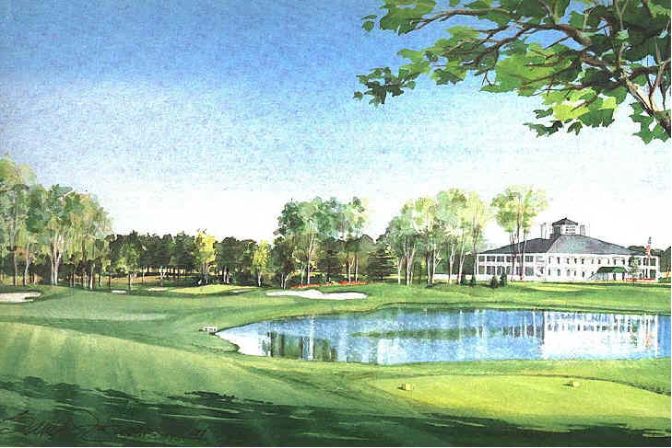
Thank You

